Slide 1

Factors that Affect Student Performance (student performance is measured by exam score for this study) Charles R. Williams, Jr.

Slide 2
Does attendance affect student performance?
Null Hypothesis
Attendance has no effect on student performance.
Alternative Hypothesis
Attendance has an effect on student performance.

Slide 3
Does the number of hours studied affect student performance?
Null Hypothesis
Hours studied has no effect on student performance.
Alternative Hypothesis
Hours studied has an effect on student performance.

Slide 4
Does attending tutoring sessions affect student performance?
Null Hypothesis
Tutoring sessions have no effect on student performance.
Alternative Hypothesis
Tutoring sessions have an effect on student performance.

Slide 5
Do previous scores affect student performance?
Null Hypothesis
Previous scores have no effect on student performance.
Alternative Hypothesis
Previous scores have an effect on student performance.

Slide 6
Methodology & Discussion of Findings
1. Data Collection
Data was collected from approximately 6,607 students.
Data included: exam scores, previous scores, hours studied, attendance, tutoring sessions, physical activity, and sleep hours.
2.Data Cleaning
The data was cleaned for accuracy.
Missing Data and/or duplicates were addressed
3. Data Analysis
Exploratory data analysis included histograms and scatterplots to understand the distribution of the data and outliers. The histograms are not included in this presentation.
Correlation coefficients were computed to understand the strength of the relationships between the variables.
Linear regression analysis was conducted to create predictor models and compute the goodness of fit for each variable and exam score.
ANOVA: Compared the data set of previous scores, hours studied, attendance, tutoring sessions, physical activity and sleep hours to identify how exam scores were impacted.

Slide 7
Discussion of Findings

Slide 8
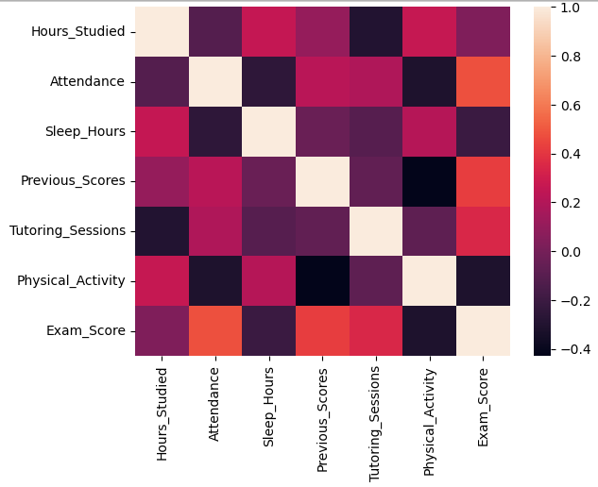
Correlation Matrix
The correlation matrix shows the strength of the relationship between the variables using colored cells. The light cells indicate a perfect correlation of 1 which makes sense because each variable is perfectly correlated with itself. The black cells indicate a negative correlation which means that as one variable increases, the other one decreases. For example, as exam scores increase, physical activity decreases. A correlation coefficient of .5 or higher is considered strong. By referencing the legend, exam score and attendance are strongly correlated which is logical.

Slide 9
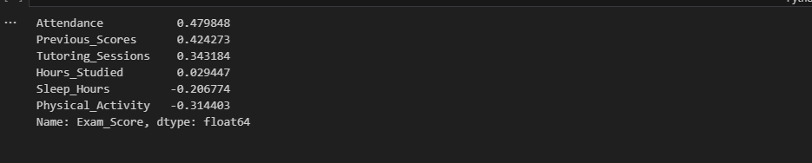
Correlation Values
The correlation values correspond with the correlation matrix in the previous slide. Attendance and previous scores have the strongest correlation with exam score. Their correlation coefficients are .48 and .42 respectively. Hours studied has the lowest correlation with .03. Sleep hours and physical activity are both negatively correlated with exam score. A negative correlation means that as one variable increases, the other decreases. More specifically, as sleep hours and physical activity increase, exam scores decrease.

Slide 10
Index data of correlation values from greatest to smallest
The index data corresponds to the previous two slides. As previously noted, attendance and previous scores have the strongest correlation with exam score.

Slide 11
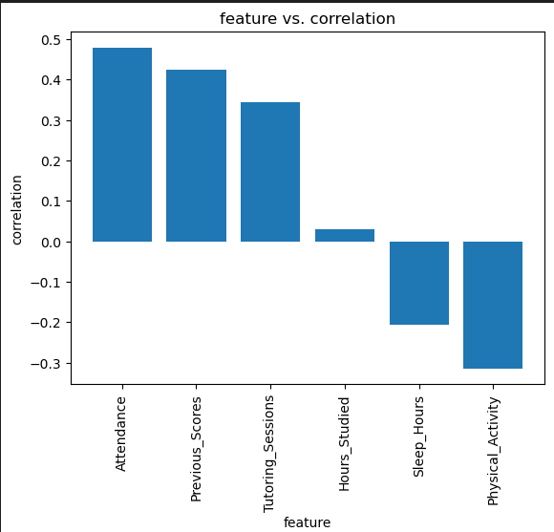
Bar Graph of Correlation Coefficients (in descending order)
This graph provides a great visual of the correlation data index shown on the previous slide.
The magnitude of the hours studied correlation coefficient is highlighted in this visual display. It’s lack of significance is indicated by the height of its bar in comparison to the other variables. Moreover, the negative correlation of sleep hours and physical activity with exam score are also easier to realize in this format.

Slide 12
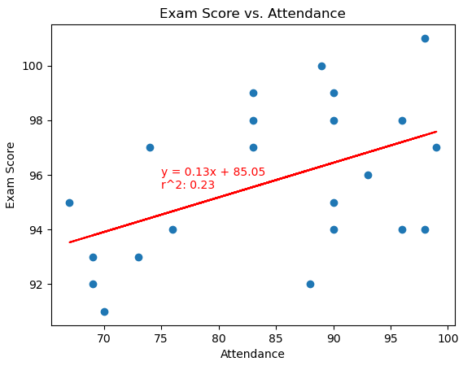
Exam Score vs. Attendance
Exam score and attendance are strongly correlated with a correlation coefficient of .48 which can be rounded up to .5.
A linear regression was performed and the goodness of fit was calculated. R² is .23 which means that the model explains 23% of the variation. Given that the r² is relatively low, could indicate that there are other factors confounded with attendance to more accurately predict exam scores.

Slide 13
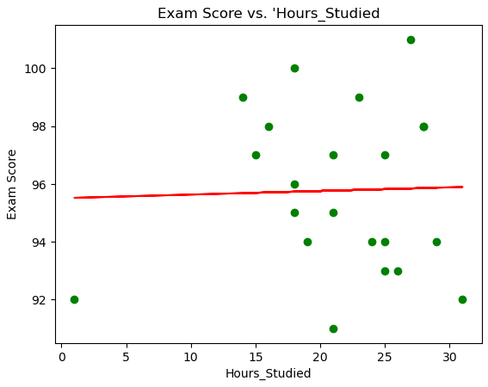
Exam Score vs. Hours Studied
Exam score and hours studied have a correlation coefficient of .03 which indicates an extremely weak or no correlation. Upon examining the scatterplot, we can see that the points do not follow a positive or negative linear pattern which corresponds to the weak r value.
Based on the weak correlation, the equation produced by linear regression would not be a strong model to predict exam scores.
This is surprising. According to Kaggle, one would expect the number of study hours to be a stronger predictor of exam scores.

Slide 14
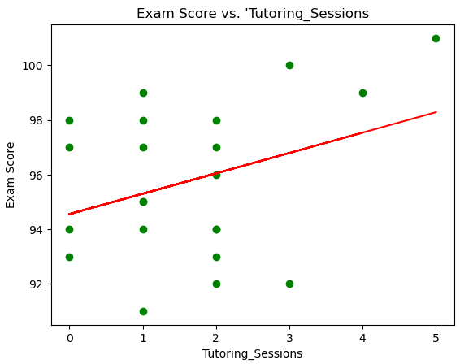
Exam score vs.Tutoring Sessions
Exam scores and tutoring sessions have a weak correlation coefficient of .34.
Linear regression was performed and the line of best fit in in red. The data is positively skewed as shown in the scatterplot which means that students participated in fewer tutoring sessions.

Slide 15
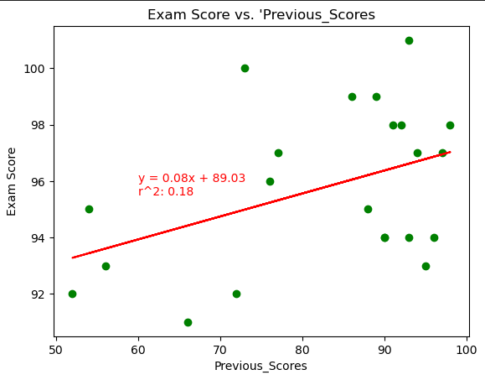
Exam Score vs. Previous Scores
Exam score and previous scores have a moderate correlation with a strength of .42.
Linear regression was performed and the goodness of fit was calculated to be .18. The r² value indicates that the model explain only 18% of the variation.
Given that the r² is relatively low, could indicate that there are other factors confounded with attendance to more accurately predict exam scores.

Slide 16
Summary
Based on the findings,
We reject the null hypothesis that attendance has no effect on student performance.
We fail to reject the null hypothesis that hours studied has no effect on student performance.
We reject the null hypothesis that tutoring sessions have no effect on student performance.
We reject the null hypothesis that previous scores have no effect on exam scores.
Additional analysis is warranted for the findings of this study to be generalizable. The linear regression model of attendance and exam scores only explains 23% of the variation which indicates that other factors could be confounded.
A recommendation would be to create and test a model that includes both attendance and previous scores to predict exam score since both of these variables have moderate/strong correlations with exam score. Another recommendation would be to examine attendance and previous scores with respect to gender as predictors of exam scores.

